Slide 1

Introduction to Educational Technology: Tools for Equitable Learning
Maribel Gonzalez
Denise McLean

Slide 2
Intention of Series
The intention of the virtual training series is to provide Beverly Park staff an overview of our STEMbyTAF Educational Framework. We hope that by the end of this four-part series you will understand how we create equitable learning opportunities for all students especially students of color.
Notes:
Hello everyone! Thank you for your commitment to our four-part introductory series on the STEMbyTAF Educational Framework. This is a reminder of our intention for sharing this information with you. We understand that these conversations deserve more time and dedication as we are beginning a journey of a pedagogical shift towards project-based learning. The intention of the virtual training series is to provide Beverly Park staff an overview of our STEMbyTAF Educational Framework. We hope that by the end of this four-part series you will understand how we create equitable learning opportunities for all students especially students of color. If you leave this session today, understanding how our four pillars with the critical foundation of equity can achieve racial justice in schools, then we as facilitators have met our goal. We will leave you with a broader vision for what this process will look in the next few months and beyond.

Slide 3
Targets and Criteria
I can explain why integrating educational technology tools into the classroom is an equitable practice.
By the end of the session, participants will be able to understand that...
as computer technology becomes more important in the classroom it becomes more invisibly woven into the demands of good teaching and learning.
when used effectively, technology in the classroom can remove barriers to learning and support students across varied contexts.

Slide 4

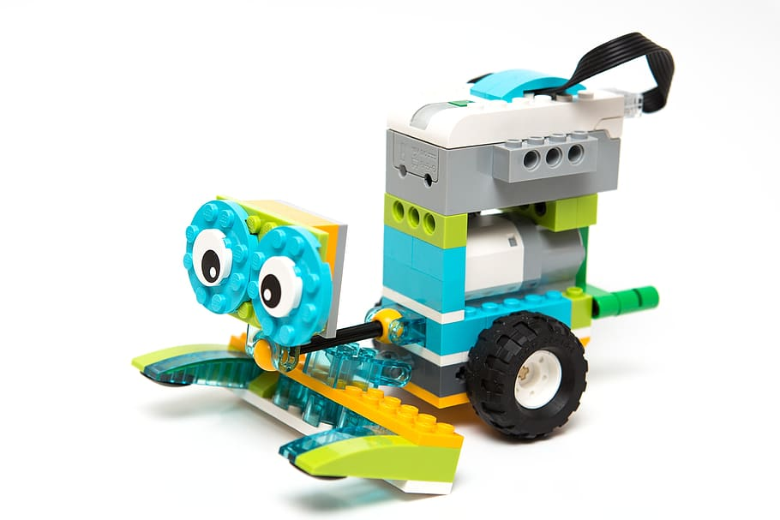
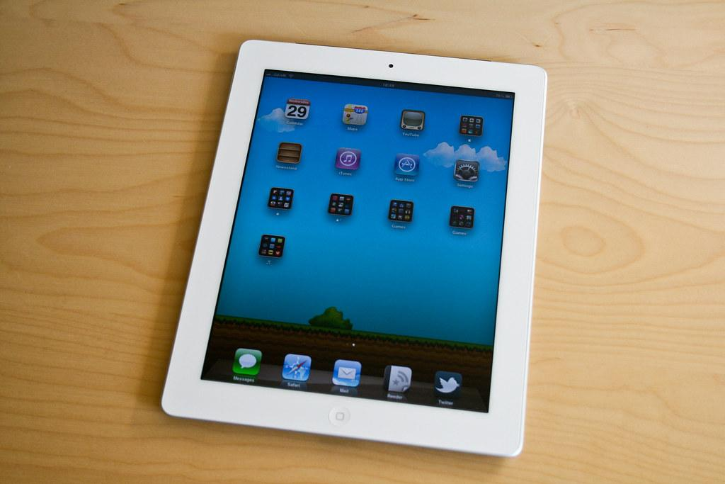
Community Builder + Check in
In the chat box, write your answer to this question:
Name technology that can be used regularly in the classroom to enhance or transform learning.
If you identify as a person of color, type C (privately or publicly).

Slide 5
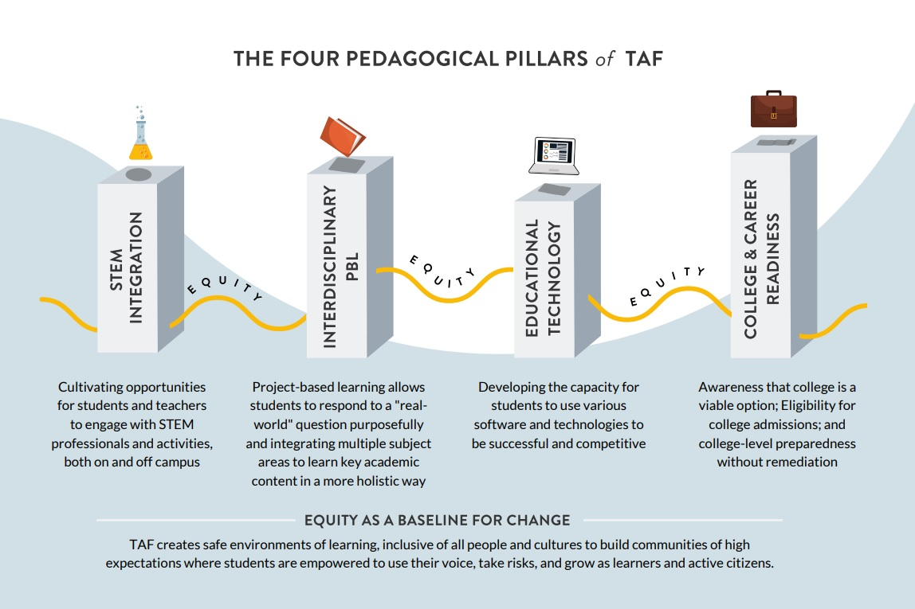
Notes:
This represents our approach to closing opportunity gaps in education. In our session today, we will discuss how educational technology is a tool for equitable learning. In the STEMbyTAF Educational Framework, we must develop our own capacity to use various software and technologies so we can help develop the capacities of all students to use various software and computer technologies to feel that they have access to the same educational pathways as everyone around them in their communities and beyond. We want to ensure all youth learn how they can solve problems using tech tools and have access to technology that can meet their needs. In other words, educational technology can remove barriers to quality education by meeting individual needs (differentiation) and help to acquiring skills needed to be included across many different fields.

Slide 6
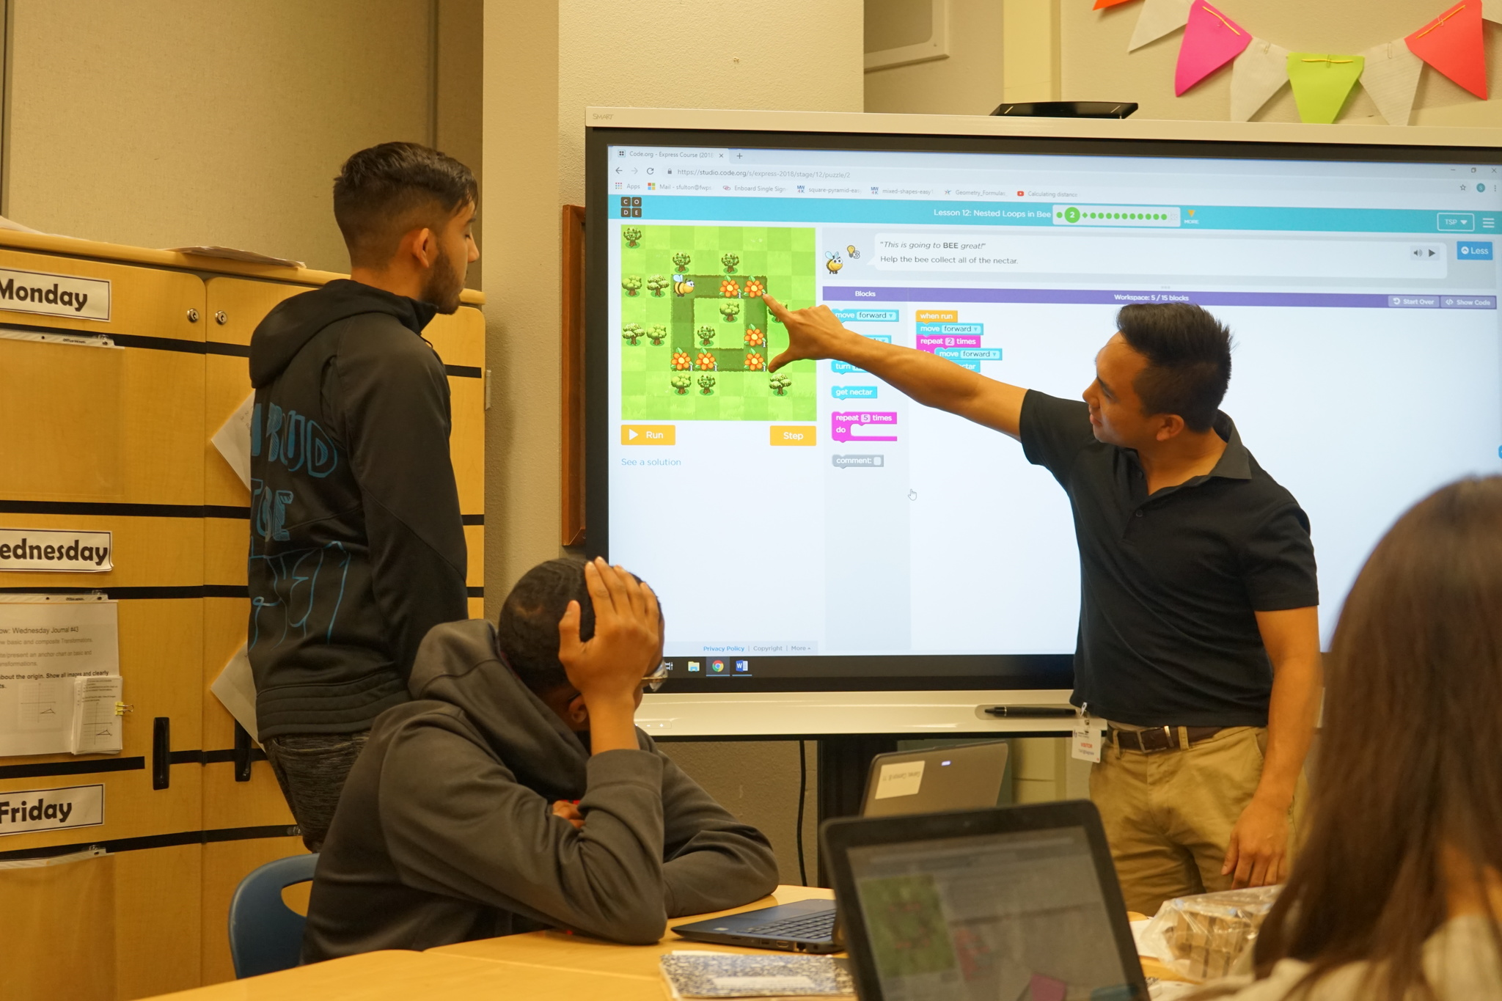
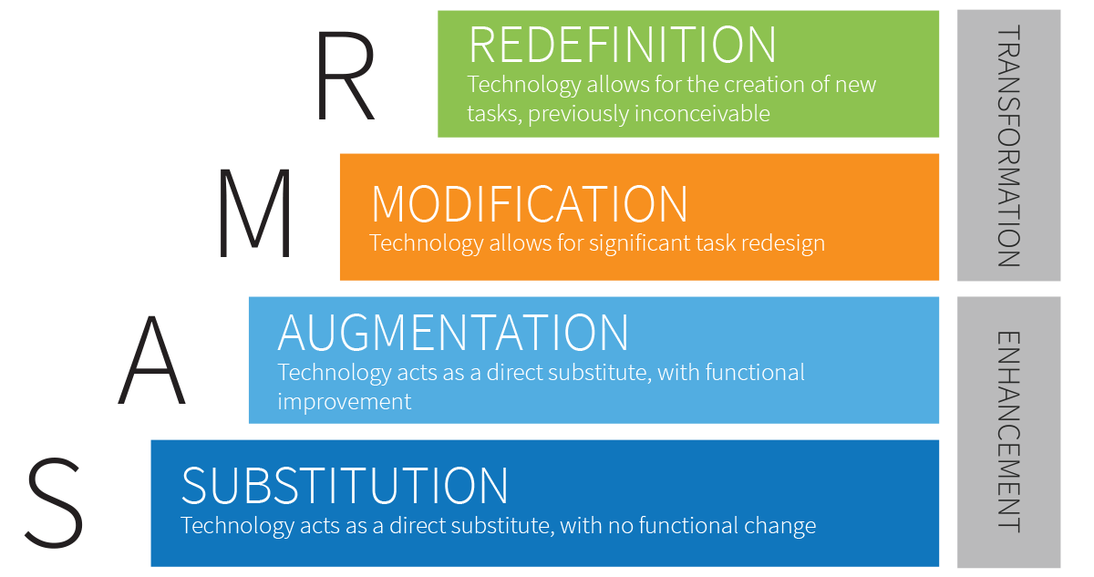
(Left) Programmers from Amazon teach students basic coding skills as they work on a project in a HS math class
(Right) The SAMR model defines the 4 levels of using technology in educational settings, from simple substitution to the redefinition of learning tasks
Notes:
Educational technology is more than just the presence of laptops or SmartBoards; it’s a fundamental shift in the approach of student demonstration of content mastery through different mediums. Tech facilitates meaningful differentiation for some tasks while redefining some tasks altogether. Tools such as Flipgrid, Padlet, Trello, Zoom/Skype in the Classroom, video/sound editing software, and coding languages give infinite opportunities for students to practice all traditional “academic” skills while preparing themselves for the future of the world.
Additionally, technological literacy and access have historically been restricted to affluent dominantly white spaces; this sort of classroom tool, while becoming more readily available in more diverse school districts, is often not supplied with supports for teachers in implementing it effectively. This is how SmartBoards become glorified projectors, and how laptop carts are typically used only for quick online research and typing still traditional assignments. Even some aspects of tech use, such as keyboarding, are infrequently given time and space in schools at this point, so educators tend to steer away from using them with students that do not currently have what is considered basic tech skills. It is essential that these are taught and given sufficient space with students to allow them to experience the full benefit and for teachers to fully utilize whatever tech they can for the benefit of students.
Technology has been shown to work as a potential equalizer in the fight for social justice; refer to reading. However, it is also incorrect to assume that technology is unbiased; technology has just as much opportunity and potential for racial bias as it is a product of biased people. As seen last week, as white males dominant the field, we see that the products and tech available and being designed now uses that lens for purpose. It can be present in the very coding of new tools.
Finally, it is imperative that teachers engage in the learning themselves, but be willing to try and use tech that they are perhaps not entirely comfortable with. There significant evidence that a large percentage of teachers avoid using tech because they themselves feel anxiety or discomfort using tools or constructing learning activities they did not experience in their own education. This, however, does a disservice to students.
TAF uses the SAMR model as a basic approach to defining learning tasks with technology.

Slide 7
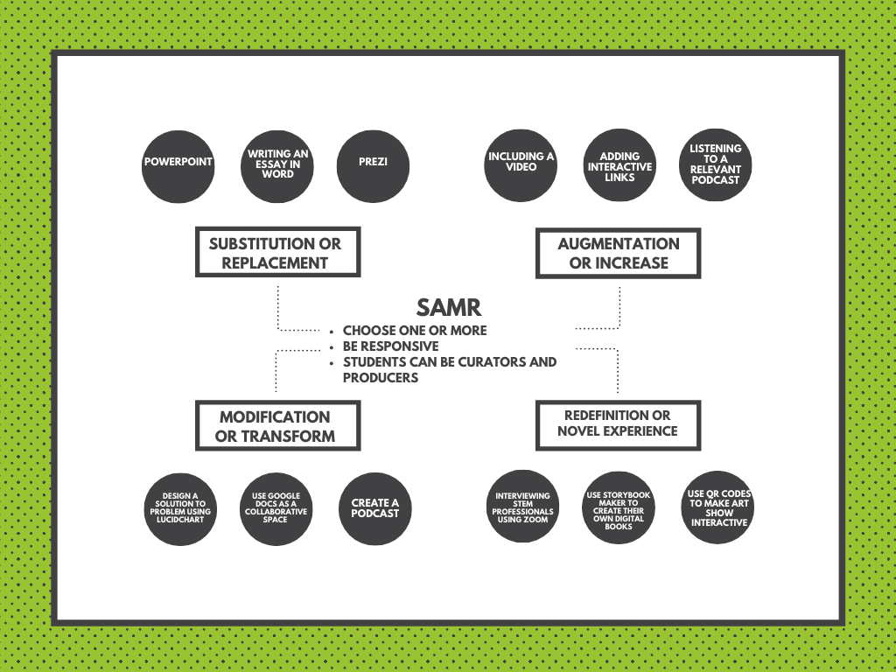

Slide 8
IN-2-OUT PROTOCOL | TIME
IN Write your answer to the first question independently and silently | 3 min
TWO Respond to the second question in your groups | 7 min
OUT Respond to this question as a whole group using the padlet | 7 min
REFLECTION Reflect as a group about the process and what came up through your discussions | 3 min
TOTAL | 20 min
Notes:
Protocols and routines build culture and high expectations for all learners. They are how we realize equitable practice.
In2Out discussions offer a great way to open up a new topic or unit. The protocol asks open ended questions to foster deep reflection and provocative discourse by scaffolding both structure and content from engaging in individual and personal work (In), to making and sharing meaning with another or a few others (2), to considering larger issues about and with community (Out). In our trainings, we use protocols and strategies that are embody PBL so you can see a model of how you could implement in your own classrooms. These strategies are useful even if you are not actively working towards solving a problem or producing a product for your project. Because it allows students practice on inquiry-driven reflection and analysis which is the basis of our educational framework.

Slide 9
Breakout Sessions
First Question: What were some of my most challenging moments of the last session and what made them so? What moments was I most proud of my efforts?
Second Question: How does teaching technology literacy support racial equity?
Third Question: How can integrating technology in professional developments and in our classrooms create access for all learners?

Slide 10
IN-2-OUT PROTOCOL | TIME
IN Write your answer to the first question independently and silently | 3 min
TWO Respond to the second question in your groups | 7 min
OUT Respond to this question as a whole group using the padlet | 7 min
REFLECTION Reflect as a group about the process and what came up through your discussions | 3 min
TOTAL | 20 min
Notes:
Protocols and routines build culture and high expectations for all learners. They are how we realize equitable practice.
In2Out discussions offer a great way to open up a new topic or unit. The protocol asks open ended questions to foster deep reflection and provocative discourse by scaffolding both structure and content from engaging in individual and personal work (In), to making and sharing meaning with another or a few others (2), to considering larger issues about and with community (Out). In our trainings, we use protocols and strategies that are embody PBL so you can see a model of how you could implement in your own classrooms. These strategies are useful even if you are not actively working towards solving a problem or producing a product for your project. Because it allows students practice on inquiry-driven reflection and analysis which is the basis of our educational framework.

Slide 11
Now
Summer
Fall
Later
Understand
Prepare and Learn
Implement
Reflect and Grow
Through the Introduction series, participants learn about the foundation and pillars of the STEMbyTAF Instructional Model.
Teachers and staff prepare for the new school year and attend the Teacher Institute in August to learn new skills and processes and to plan initial projects.
Teachers implement their learning and plans with students, adjusting to meet student needs and interests with the support of the coach.
Staff reflects on the implementation of projects and strategies and set personal and site goals for learning and growth.

Slide 12
Next Steps and Closing
Flipgrid: Name one tool you would love to try. What kind of support do you need? bit.ly/TAFedtech
Evaluation form: https://forms.gle/DoQbXARXr17EmEk77
Clock Hour Form w/ eSignature will be sent out this afternoon

